Slide 1
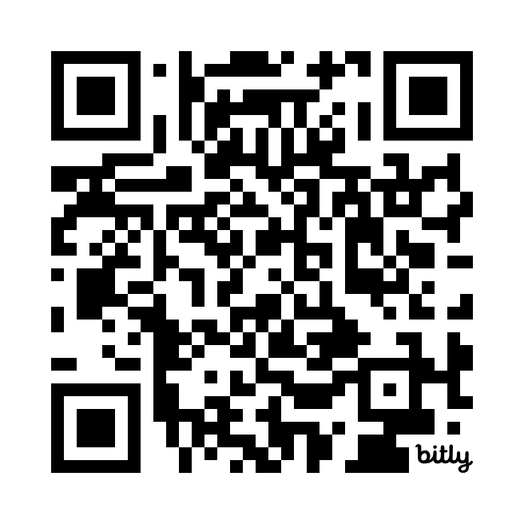
A Warm Welcome to the UST AccelerateUS event.
Keynote Speaker
Dr Yashar Baradaranshokouhi – SL LTU
Shajahan Pulikkal
Reshni Kochunni
Scan the QR Code for event schedule

Slide 2
Keynote Speakers
Praveen Prabhakaran
CDO UST Global
Heather Dawe
Chief Data Scientist UST UK
March 2025

Slide 3

Ice Break Activity (5-10 min)
Fun Quiz: AI in QA!
ID: 133-500-896
Grab your phones and go to vevox.app, enter the ID.
Questions about AI tools, benefits, etc.
Have fun!
Notes:
Vevox to go here
Perhaps, a word cloud here.

Slide 4
Agenda (Session 1)
AI in Testing: Why Now? (context and benefits)
AI Testing Tools & Best Practices (overview of current solutions)
Case Studies (real examples in healthcare and risk management)
Interactive Breakouts (group discussion on applying AI)
Next Steps (toward an action plan)
Notes:
Walk through the agenda. Emphasize interaction We’ll not just talk at you; there’s a quiz and group work, so we learn from each other.
Ensure everyone knows about the breakout and that they’ll get to choose a topic.

Slide 5
Intro AI-Led Testing
Day 1 - Session 1
10:30 – 12:30
Introduction AI’s Role in Software Testing – Benefits, Tools & Best Practices
March 2025

Slide 6
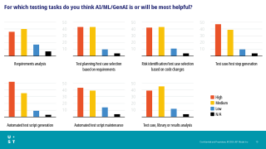
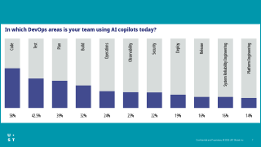
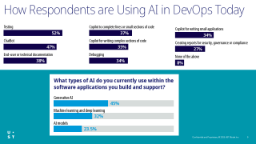
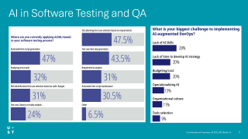
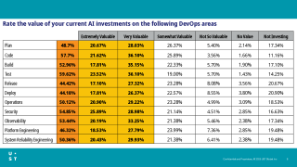

Slide 7
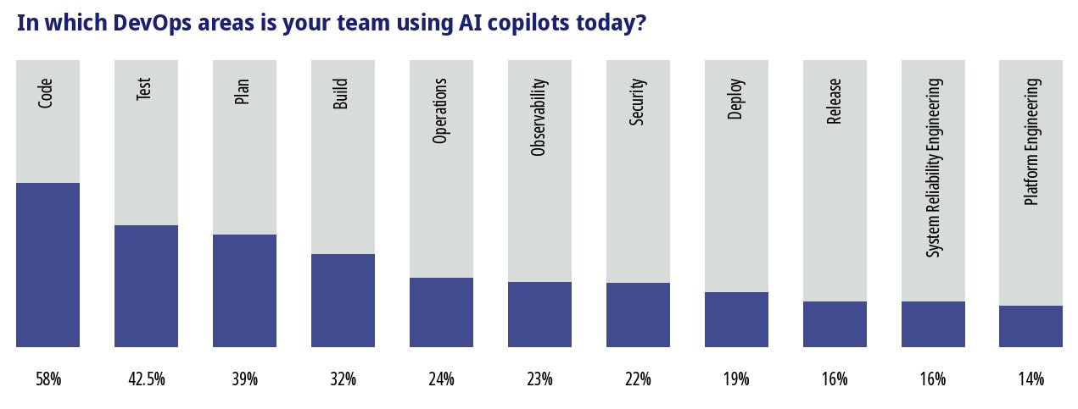

Slide 8
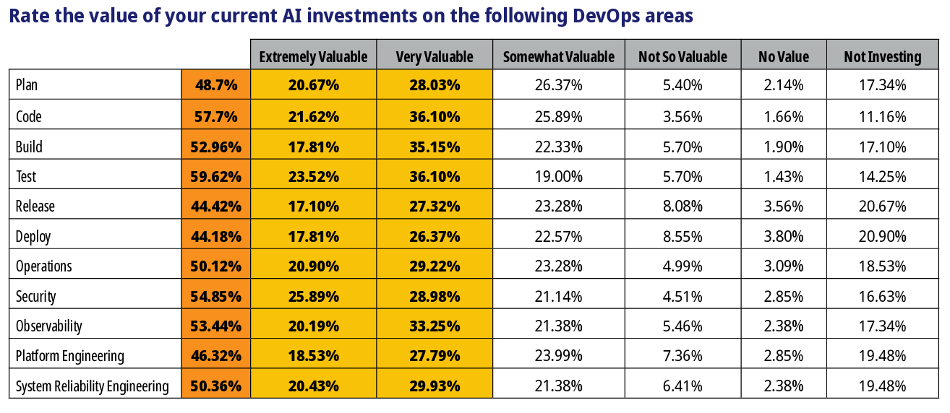

Slide 9
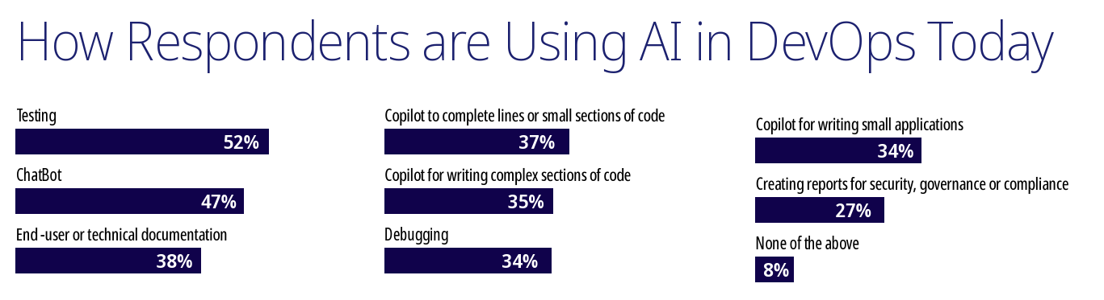
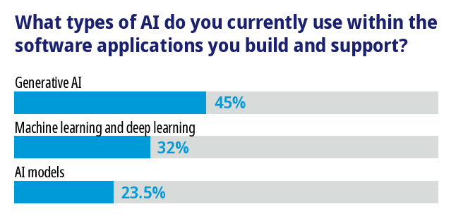

Slide 10
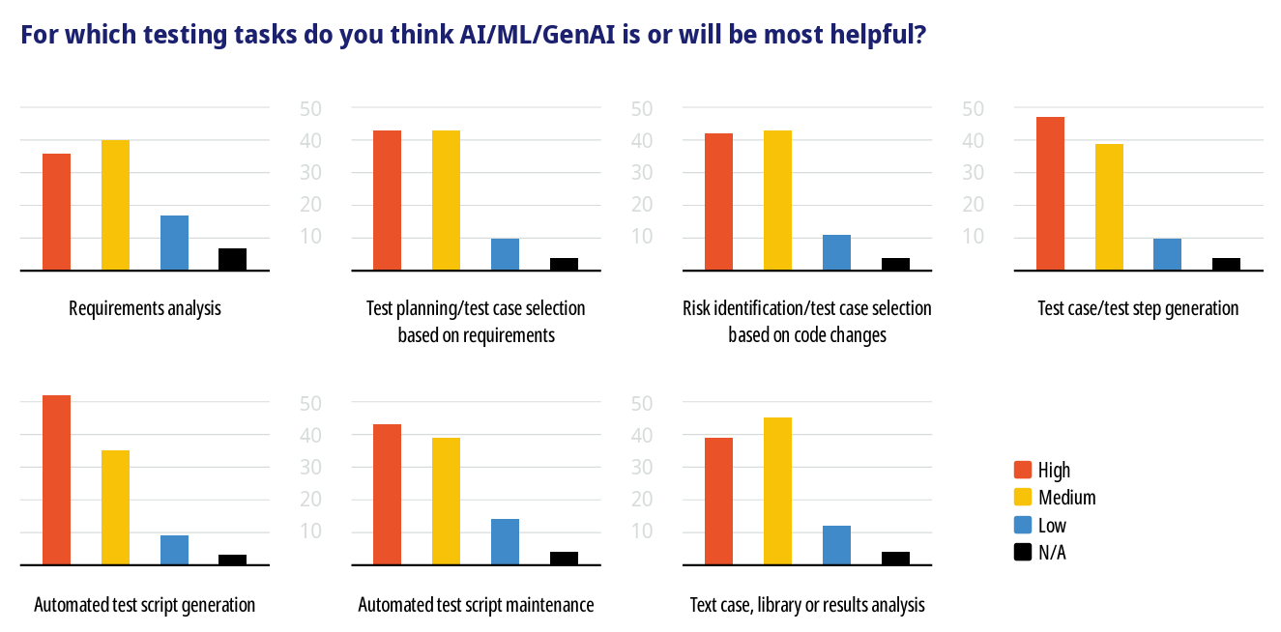
Notes:
https://www.frugaltesting.com/blog/generative-ai-and-reinforcement-learning-in-software-testing#:~:text=Test%20Creation%20Automated%20generation%20of,to%20tests%20as%20software%20changes

Slide 11
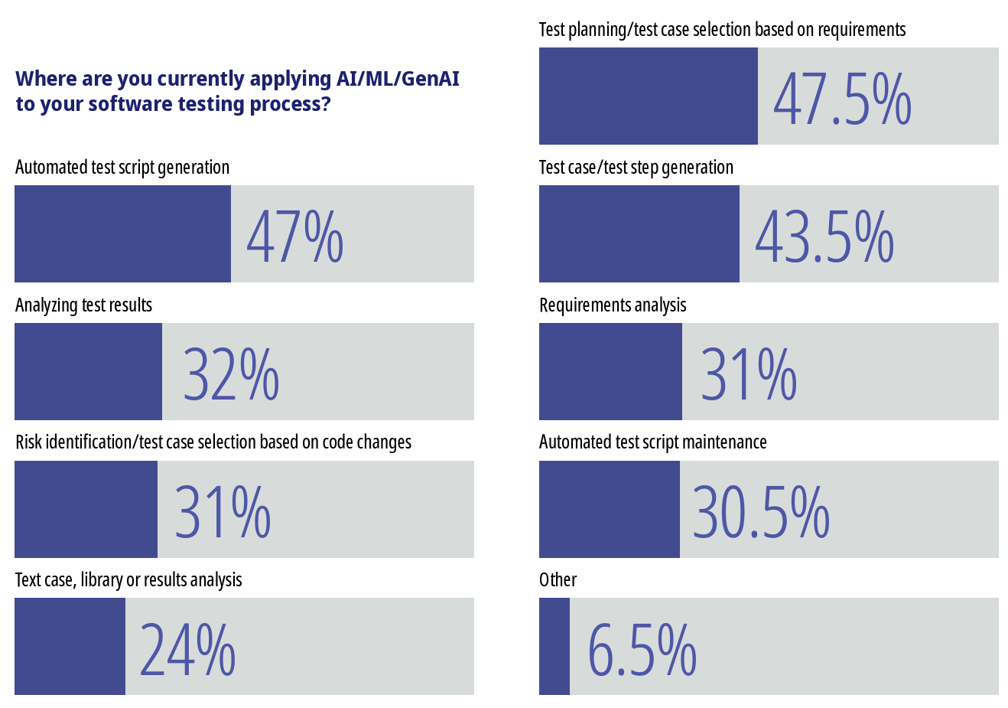
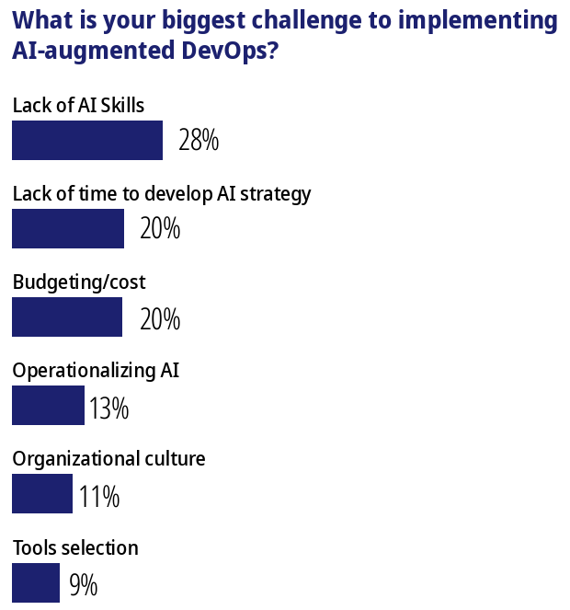
AI in Software Testing and QA
Notes:
https://www.frugaltesting.com/blog/generative-ai-and-reinforcement-learning-in-software-testing#:~:text=Test%20Creation%20Automated%20generation%20of,to%20tests%20as%20software%20changes

Slide 12
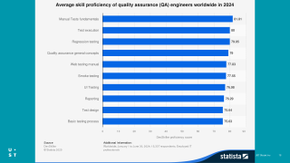
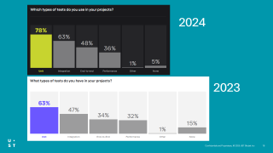
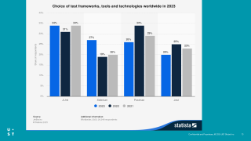
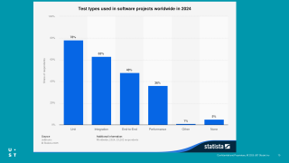
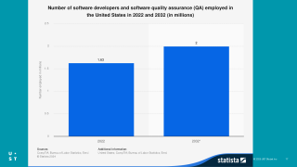
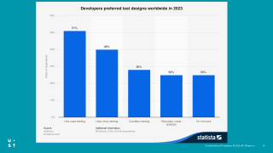

Slide 13
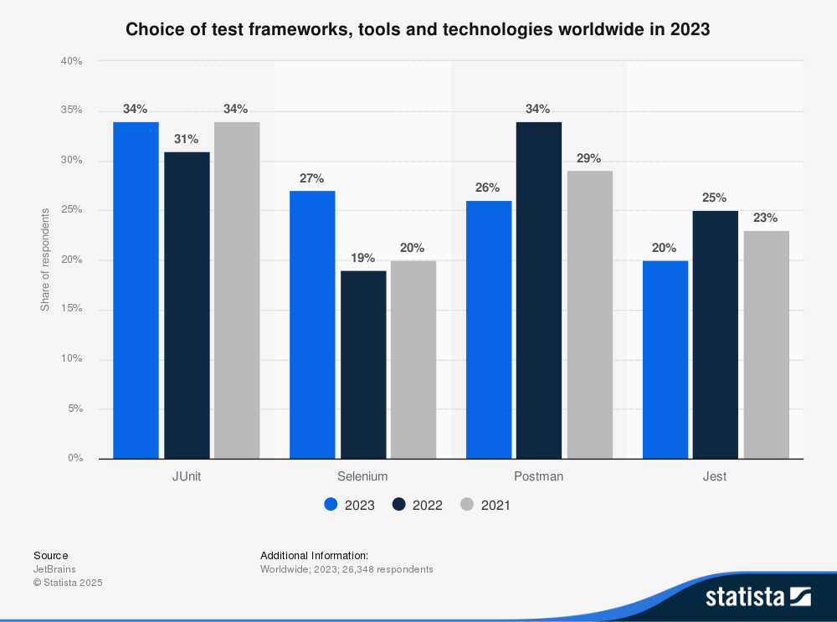
Notes:
Main test frameworks and tools worldwide 2023| Statista

Slide 14
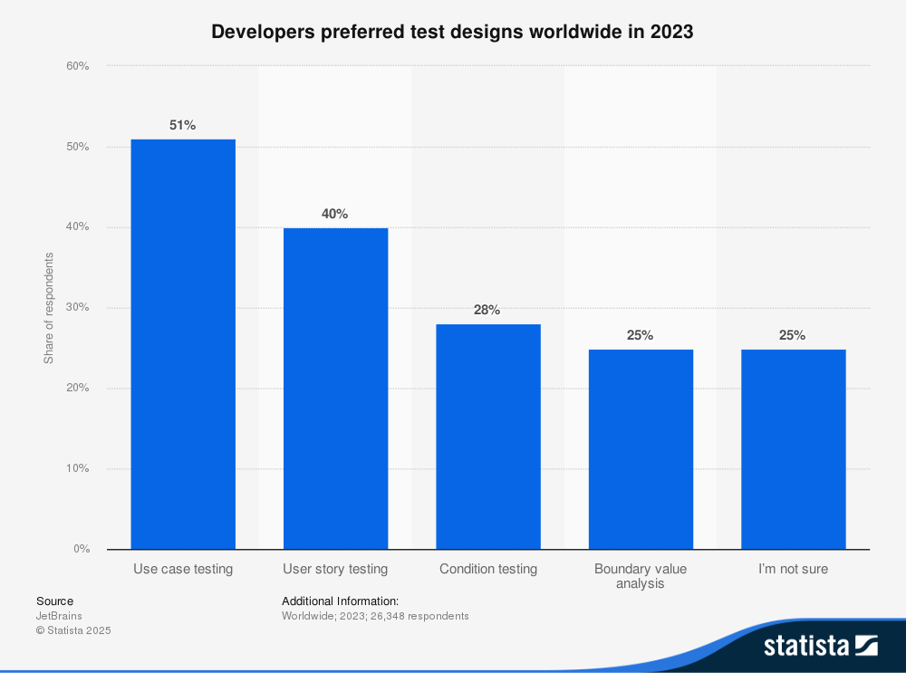
Notes:
Test design techniques worldwide 2023| Statista

Slide 15
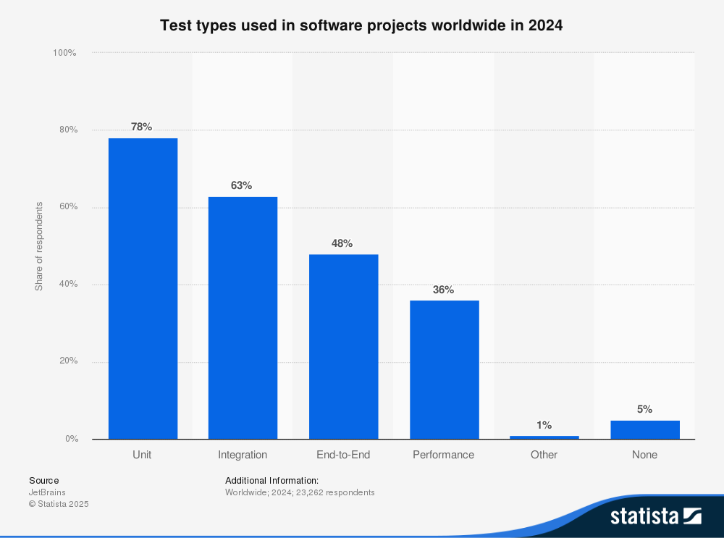
Notes:
Project test types worldwide 2024| Statista

Slide 16
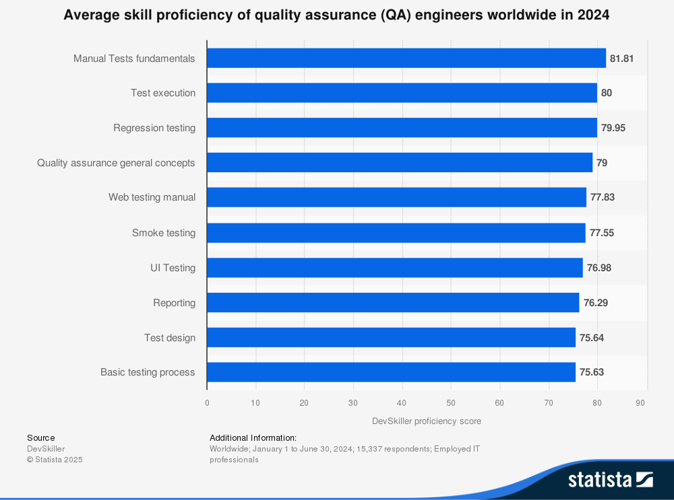
Notes:
QA engineers skill proficiency worldwide 2024| Statista

Slide 17
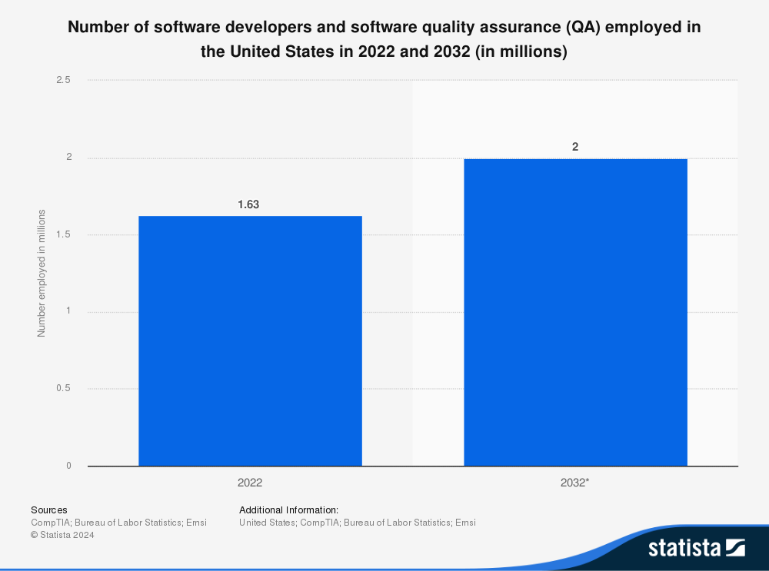
Notes:
U.S. software developers and software QA jobs 2022-2032| Statista
CompTIA State of the Tech Workforce 2024 vFinal (page 7, 9)
CompTIA State of the Tech Workforce UK_Template_vFinal (page 30)

Slide 18
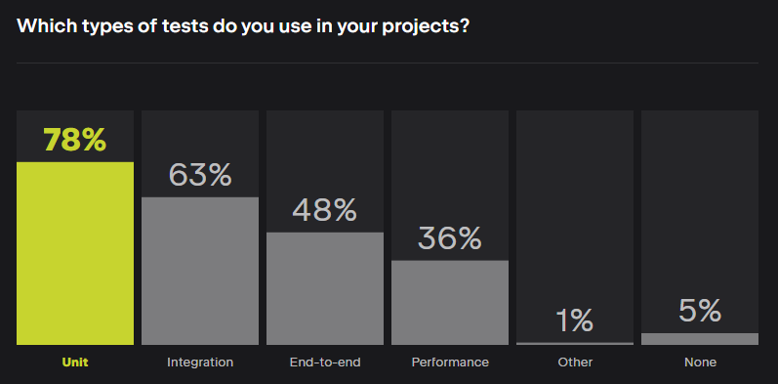
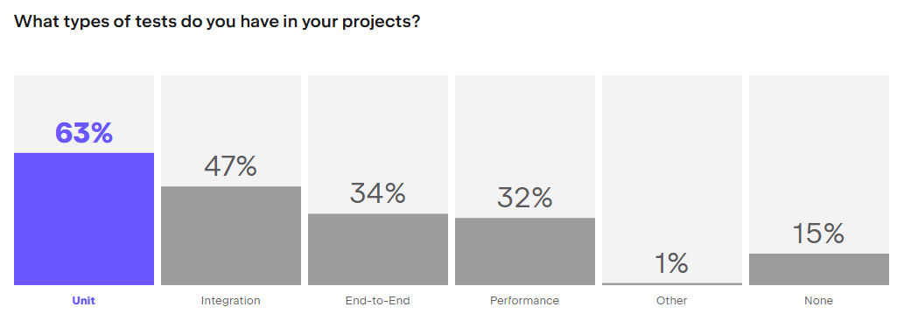
2024
2023
Notes:
Software Developers Statistics 2024 - State of Developer Ecosystem Report | JetBrains: Developer Tools for Professionals and Teams

Slide 19
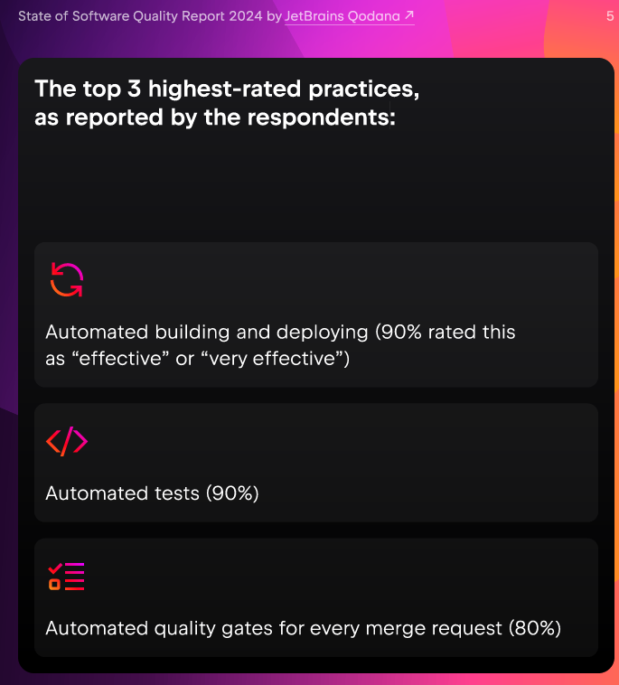
Notes:
https://lp.jetbrains.com/software-quality-report-2024-by-qodana/#:~:text=27%25,most%20resource%2Dintensive%20quality%20practice

Slide 20
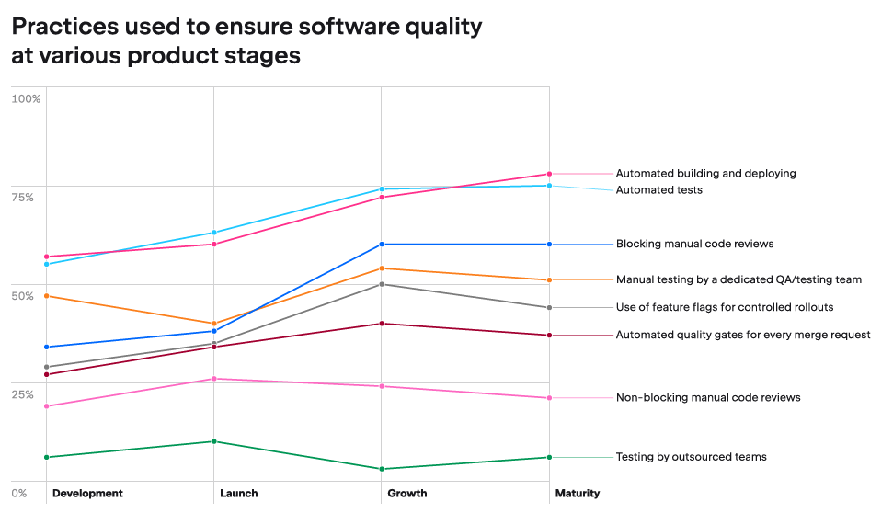
Notes:
https://lp.jetbrains.com/software-quality-report-2024-by-qodana/#:~:text=27%25,most%20resource%2Dintensive%20quality%20practice

Slide 21
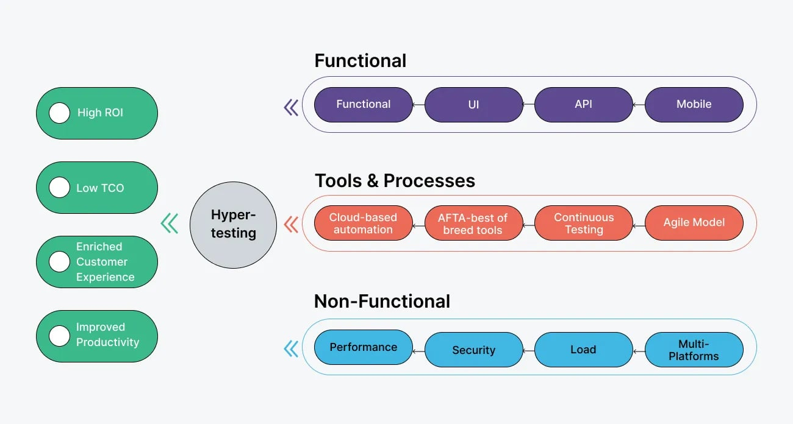

Slide 22
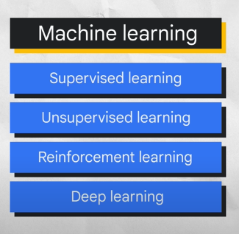
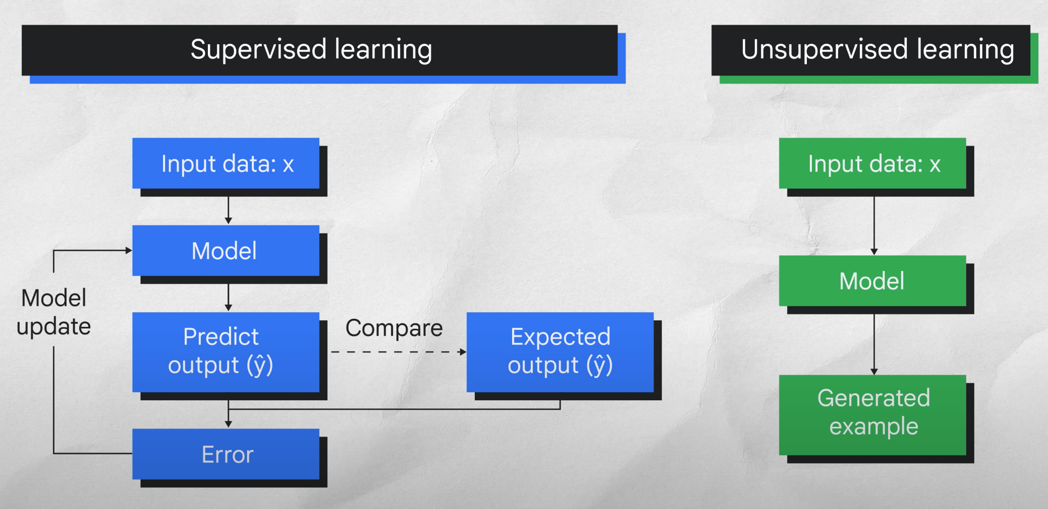
Key Components of AI (Relevant to Testing)
AI, ML, and DL Overview
Artificial Intelligence (AI): Making machines intelligent.
Machine Learning (ML): Achieving AI by learning from data, includes supervised, unsupervised, and reinforcement learning.
Deep Learning (DL): Advanced subset of ML using multi-layer neural networks for complex tasks like image recognition, natural language processing, and speech recognition.
Relationships and Structure
Neural Networks: Core technology behind Deep Learning.
Inspired by human brain structure.
Adjust connections based on training data.
Multi-layer networks excel at discovering complex patterns.
Hierarchy:
Deep Learning ⊂ Machine Learning ⊂ Artificial Intelligence
Notes:
https://www.frugaltesting.com/blog/generative-ai-and-reinforcement-learning-in-software-testing#:~:text=Test%20Creation%20Automated%20generation%20of,to%20tests%20as%20software%20changes

Slide 23
Key Components of AI (Continued)
Natural Language Processing (NLP):
Enables computers to understand human language.
Example: Generate test cases from requirements documents.
Large Language Models (LLMs):
Deep Learning models trained on extensive text data.
Capable of generating text, translations, and creative content.
Example: Test case/documentation generation; identify inconsistencies in requirements.

Slide 24
Example: Integrating NLP with Selenium
Natural Language Processing (NLP) enables computers to interpret human language.
Selenium automates web browser interactions for testing.
Integration Goal:
Create intelligent, flexible, and maintainable automated tests.
Improved Test Case Creation
Natural language descriptions instead of rigid scripts.
More readable and maintainable test cases.
Dynamic Test Data Generation
Automatically generate realistic test inputs.
Useful for forms, search fields, input elements.
Enhanced Test Reporting
Generate clear, informative reports in plain language.
Easier for stakeholders to understand test results.
Self-Healing Tests
Tests adapt to UI changes (e.g., button labels).
Find elements based on meaning rather than exact text.
Requirements to Test Cases
Automatically generate test cases from requirement documents.

Slide 25
How to Integrate NLP with Selenium
Step 1: Select NLP Libraries
NLTK (Natural Language Toolkit) - versatile Python NLP library.
spaCy - advanced Python NLP library.
Transformers (Hugging Face) - supports advanced AI models like LLMs.
Cloud NLP APIs - Google Cloud Natural Language API, AWS Comprehend.
Step 2: Use Selenium WebDriver
Core tool for browser automation.
Step 3: Connect NLP with Selenium
Write code to bridge NLP analysis and Selenium commands:
Interpret natural language inputs.
Extract actions, targets, and data.
Translate these into Selenium commands.

Slide 26
Example Scenario
Traditional Selenium Script
driver.find_element(By.ID, "login-button").click()
driver.find_element(By.ID, "username").send_keys("testuser")
With NLP Integration:
process_natural_language("Click the login button and enter 'testuser' as the username.")
NLP function interprets and translates natural instructions into Selenium actions automatically.

Slide 27
Limitations of Basic NLP Approach
Slide 2: Rule-Based Parsing
Struggles with varied language and ambiguity.
Requires extensive manual coding.
Limited Context & Reasoning
Cannot interpret contextual or indirect instructions.
Maintenance Difficulty
UI or instruction changes require significant code updates.
How LLMs Transform Test Automation
Semantic Understanding:
Accurately interprets varied, complex natural language instructions.
Contextual Awareness:
Understands and maintains context across test steps.
Dynamic Adaptation:
Automatically adapts tests to UI and instruction changes.
Robustness:
Handles sophisticated instructions involving logic and context.

Slide 28
Advanced Capabilities of LLMs
Advanced Capabilities of LLMs
Test Case Generation & Repair:
Generates test cases from user stories or requirements.
"Self-heals" test cases when UI elements change.
Complex Instruction Handling:
Processes instructions like:
"Log in as the user with the most recent order."
Code Generation:
Directly generates Selenium scripts from natural language instructions.

Slide 29
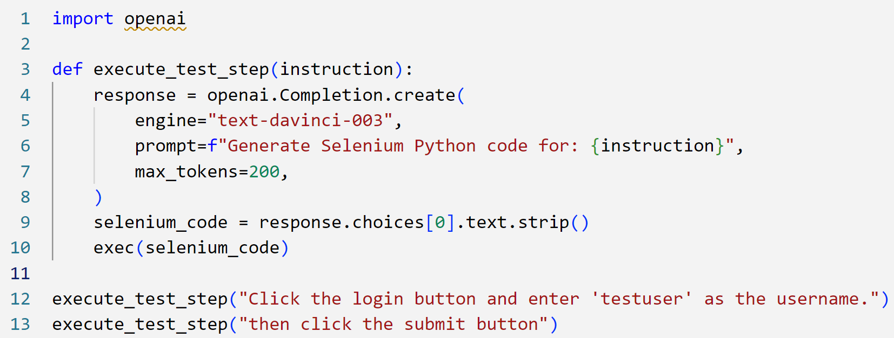
Example: LLM-Driven Selenium Automation
Key Improvements with LLMs
Enhanced Adaptability:
Reduced need for extensive coding.
Improved Maintainability:
Automatic handling of UI changes.
Higher Test Robustness:
Better handling of complex instructions.
Contextual Intelligence:
Understands conversation and context in test cases.

Slide 30
Human in the Loop
Why the "Human in the Loop" is Crucial with LLMs
Despite advanced capabilities, LLMs require human oversight.
Humans ensure accuracy, relevance, and reliability of automated testing.
Ensuring Accuracy & Preventing Hallucinations
LLMs can occasionally produce inaccurate or nonsensical outputs ("hallucinations").
Humans review, validate, and correct LLM-generated test cases or reports.
Human judgment is essential for maintaining test reliability and quality.
Handling Ambiguity & Complex Scenarios
Natural language instructions can be ambiguous.
Humans clarify instructions, provide additional context, and handle edge cases.
Human intuition guides nuanced decisions that AI may misinterpret.
Providing Domain Expertise & Business Context
LLMs have general knowledge but lack specific business or domain insights.
Humans provide specialized knowledge about applications, users, and business needs.
Ensures tests align closely with business objectives and relevance.

Slide 31
Defining Test Strategies & Priorities
Defining Test Strategies & Priorities
Humans establish overall testing strategies and priorities.
Identify critical areas, assess risks, and determine testing depth.
Human guidance defines what is essential to test.
Ethical & Legal Oversight
AI-driven testing raises ethical/legal issues (privacy, bias, security).
Humans ensure testing practices comply with ethical standards and regulations.
Humans make final decisions on data usage and testing boundaries.
Continuous Improvement & Feedback
Human feedback refines LLM performance.
Reviewing and correcting outputs improves model accuracy.
Humans confirm test quality and effectiveness, ensuring continuous enhancement.
Creativity & Exploratory Testing
LLMs may lack the creativity required for exploratory testing.
Humans bring intuition and imagination, uncovering hidden or unexpected defects.
Humans explore applications from a real user's perspective.
Humans remain central to ensuring responsible and effective use of LLMs.
Notes:
Summary: Human + LLM Collaboration
Humans remain central to ensuring responsible and effective use of LLMs.
Combination of human judgment and LLM capabilities provides robust testing.
AI enhances testing processes, but humans ensure alignment with human values and business goals.

Slide 32

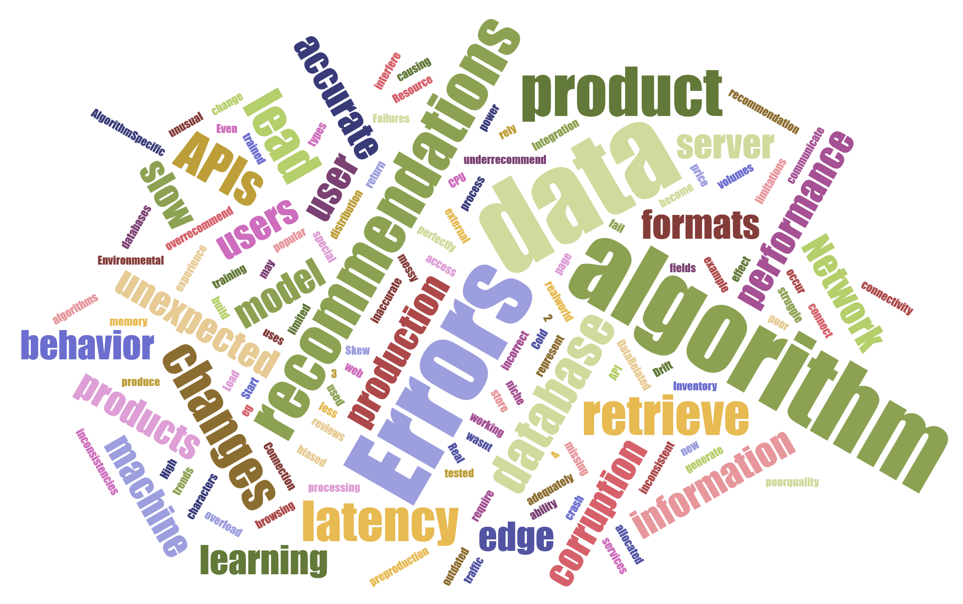

Slide 33
Software Testing Life Cycle
Manual Testing
Requirement Analysis
Test Planning
Test Case Design
Test Execution
Defect Reporting
Re-testing & Regression
Closure
Automated Testing
Requirement Analysis
Automation Feasibility Analysis
Test Planning & Design
Environment Setup & Test Scripting
Test Execution
Defect Reporting & Analysis
Maintenance & Enhancement
Closure
AI Augmented Testing
Requirement Analysis
Test Planning & AI Strategy
Test Data & Scenario Generation
Test Script & Model Training
Test Execution & Autonomous Testing
Real-time Defect Detection & Prediction
Human-in-the-Loop Feedback
Maintenance & Continuous Learning
AI Model Refinement
Closure
Notes:
Manual Testing Life Cycle
Requirement Analysis: Understanding business and user requirements.
Test Planning: Creating test strategy and plan.
Test Case Design: Writing detailed test scenarios manually.
Test Execution: Manually running tests and reporting issues.
Defect Reporting: Logging defects manually, communicating back to developers.
Re-testing & Regression: Manually re-executing tests after fixes.
Closure: Documenting test outcomes, preparing test reports.
Automated Testing Life Cycle
Requirement Analysis: Same as manual testing.
Automation Feasibility Analysis: Identifying tests suitable for automation.
Test Planning & Design: Creating automation frameworks, defining reusable scripts.
Environment Setup & Test Scripting: Developing and scripting automated tests.
Test Execution: Automated running of scripts; generating reports.
Defect Reporting & Analysis: Automated logs, but manual defect analysis.
Maintenance & Enhancement: Updating automated scripts as application changes.
Closure: Reviewing automated results, refining automation scripts.
3. AI-Augmented Testing Life Cycle
Requirement Analysis: Same as previous methods.
Test Planning & AI Strategy: Deciding areas where AI models can assist (e.g., test selection, data generation, defect prediction).
Test Data & Scenario Generation: Leveraging AI to automatically generate test data, scenarios, and edge cases.
Test Script & Model Training: Developing tests and training AI models with historical and live test data.
Test Execution & Autonomous Testing: AI-driven automated execution, exploratory tests, dynamic test case adaptation based on results.
Real-time Defect Detection & Prediction: AI identifies anomalies, clusters defects, and predicts high-risk areas proactively.
Human-in-the-Loop Feedback: Tester validates AI outputs, giving feedback to continuously improve the AI model.
Maintenance & Continuous Learning: AI self-improves through machine learning, reducing manual intervention.
Closure & AI Model Refinement: Reviewing test outcomes, refining AI strategies, and improving predictive accuracy.
What’s Different as We Move Towards AI?
Shift in Human Roles: From direct execution (manual) to script maintenance (automation), to strategic oversight and validating AI-driven results.
Increased Proactiveness: Moving from reactive (manual) and planned-execution (automation) to predictive, proactive anomaly detection (AI).
Continuous Learning and Adaptation: AI introduces an evolving system where test scenarios automatically adapt based on historical and runtime data, reducing static scripting and maintenance overhead.
Intelligent Prioritization & Coverage: AI identifies highest-risk scenarios and optimizes coverage dynamically, significantly enhancing testing efficiency and effectiveness.
Reduction in Maintenance Effort: AI systems autonomously handle maintenance through self-healing test cases, reducing manual script maintenance.
Real-Time Defect Insights: Faster, more immediate identification and prediction of issues, enabling quicker corrective action.

Slide 34
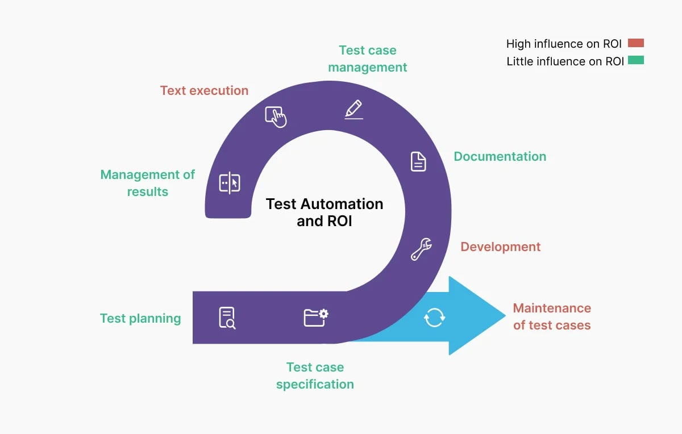
Notes:
https://www.globalapptesting.com/best-practices-automated-testing

Slide 35
Manual Aspects of Test Planning
Defining Test Strategy
High-level decisions guided by experience and judgment.
Factors: Risk, business needs, project constraints.
Determining Test Scope
Identify what's in/out of testing.
Collaboration with stakeholders; prioritization.
Risk Analysis
Subjective assessment of risks.
Manual identification; strategic thinking required.
Creating Test Plans
Document objectives, scope, resources, schedules.
Often manual but supported by templates/tools
Test Management Tools
Examples: TestRail, Jira, Azure DevOps.
Features: test case management, progress tracking, reporting.
Requirements Management Tools
Examples: IBM Rational DOORS.
Benefits: Traceability, comprehensive coverage.
Estimation Tools
Support estimating test efforts/resources.
Historical data, algorithm-based; human input essential.
Reporting and Metrics
Automate generation of test reports, metrics, insights.

Slide 36
Defect Reporting in Manual Testing
Manual testing relies on human observation and documentation.
Accurate defect reporting is critical for successful software fixes.
Identify the Defect
Execute test cases or exploratory testing.
Note unexpected behavior or errors.
Document the Defect
Short, clear summary of the issue.
Detailed steps to reproduce.
Comparison: expected vs. actual results.
Environment details (OS, browser, device).
Attach visual proof (screenshots/videos).
Assign severity and priority.
3. Report the Defect
Use bug-tracking tools (Jira, Bugzilla, Azure DevOps).
For smaller projects, use documents or spreadsheets.
4. Verify and Close
Verify the developer's fix.
Close defect if resolved, or reopen if issue persists.

Slide 37
Key Transitions in Testing Evolution
Manual Testing (Pre-1980s)
Transition to Automation (1980s-2000s)
Agile & Continuous Testing (2010s)
AI-Driven Testing (2020s and beyond)
Ad-Hoc: Structured Manual Testing
Informal processes evolved to documented, structured test plans.
Manual: Scripted Automation
Automation of repetitive tasks through scripts and specialized tools.
Scripted: Intelligent Automation
Leveraging AI and ML for adaptive and intelligent testing solutions.

Slide 38
Quick Timeline
Transition to Automation (1980s–2000s)
1980s: Personal Computer Revolution
Diverse software, demand for efficient testing
Emergence of early automation tools (regression testing)
1990s: GUI Testing
Complex graphical interfaces
Tools: WinRunner, Rational Robot
Late 1990s–2000s: Web Application Testing
Rise of web applications
Tools: Selenium
Advanced test automation frameworks
2000s: Keyword & Data-Driven Testing
Flexible, maintainable tests
Popular tools: QTP/UFT, JUnit, TestNG
Agile and Continuous Testing (2010s)
2000s–2010s: Agile Development
Emphasis on CI/CD
Automation crucial for rapid feedback
Tools: Jenkins, GitLab CI/CD
Mobile Testing (2010s)
New challenges from mobile apps
Tools: Appium, Espresso
API Testing (2010s)
Rise of microservices and APIs
Tools: Postman
AI-Driven Testing (2020s and Beyond)
Integration of AI & Machine Learning
Automatic generation of test cases
Analysis of results; defect prediction
Visual testing, self-healing tests
LLMs for test cases and documentation
Continuous Testing Enhanced by AI
Improved test efficiency
Real-time feedback and optimization

Slide 39
Feature | Generative AI Testing | Traditional Testing
Test Creation | Automated generation of test cases based on AI models. | Manual creation of test cases by testers based on specifications.
Scope of Testing | Can create complex, dynamic tests including edge cases automatically. | Focuses on predefined scenarios and often misses edge cases.
Speed | Much faster, as tests are generated and executed automatically. | Slower, as manual effort is required to write and run tests.
Adaptability | Highly adaptable to changes in the software, with tests evolving in real-time. | Less flexible, requiring manual updates to tests as software changes.
Cost Efficiency | Higher initial setup cost but reduces testing costs in the long run due to automation. | Lower initial cost but potentially higher long-term costs due to manual work.
Test Coverage | Broader test coverage, potentially uncovering more bugs and issues. | Limited to the scenarios that testers anticipate and include.
Skill Requirements | Requires expertise in AI and machine learning to set up and maintain. | Requires traditional testing skills, less emphasis on advanced technologies.
Innovation | Encourages continuous improvement and innovation in testing strategies. | Relies on established methods, less dynamic in approach.
Bias | Minimized bias due to automated, data-driven test generation. | Potential for human bias in selecting and designing test cases.

Slide 40
The State of Software Testing (Why Consider AI?)
High volume & velocity: Modern systems have thousands of test cases and frequent releases (e.g., CI/CD) – manual testing can’t keep up.
Complexity: Apps span web, mobile, cloud – testing is more complex (and humans are prone to miss things in that complexity).
QA Bottlenecks: Tight deadlines but lengthy regression tests; limited QA resources.
AI Maturity: AI tech has advanced – tools can now generate, execute, and adapt tests intelligently.
Notes:
Paint the picture of current challenges. “For example, Microsoft had a project with 65k tests taking 3 days to run ​software-lab.org
imagine trying to optimize that! AI is one approach to tackle such challenges. Mention that AI is a means to handle scale and speed.

Slide 41
AI’s Role – What Can AI Do in Testing?
Generate Test Scenarios: AI can create test cases from requirements or user data (covering more paths automatically).
Accelerate Execution: Runs tests faster, in parallel, 24x7 (e.g., regression suites overnight) Enhance Coverage: Finds edge cases humans might miss, suggests additional tests for untested code​.
Predict Defects: Analyses past results to flag high-risk areas (focus testing where bugs are likely)
Self-Heal & Adapt: Automatically fixes broken tests (locators, waits) when the app changes.
Continuous Testing Support (CI/CD): Seamlessly integrates into CI pipelines for constant feedback​.
Notes:
Define each point with a quick example. For instance, “Generate Test Scenarios – a tool might read your requirements doc and generate login test cases with different roles.” When discussing self-healing, maybe recount: “Have you ever had an automated test break because a button ID changed? AI can detect that and use an updated selector automatically.” Keep it high-level; details on tools come later.
​HEALTHCARE.MINDBOWSER.COM.

Slide 42
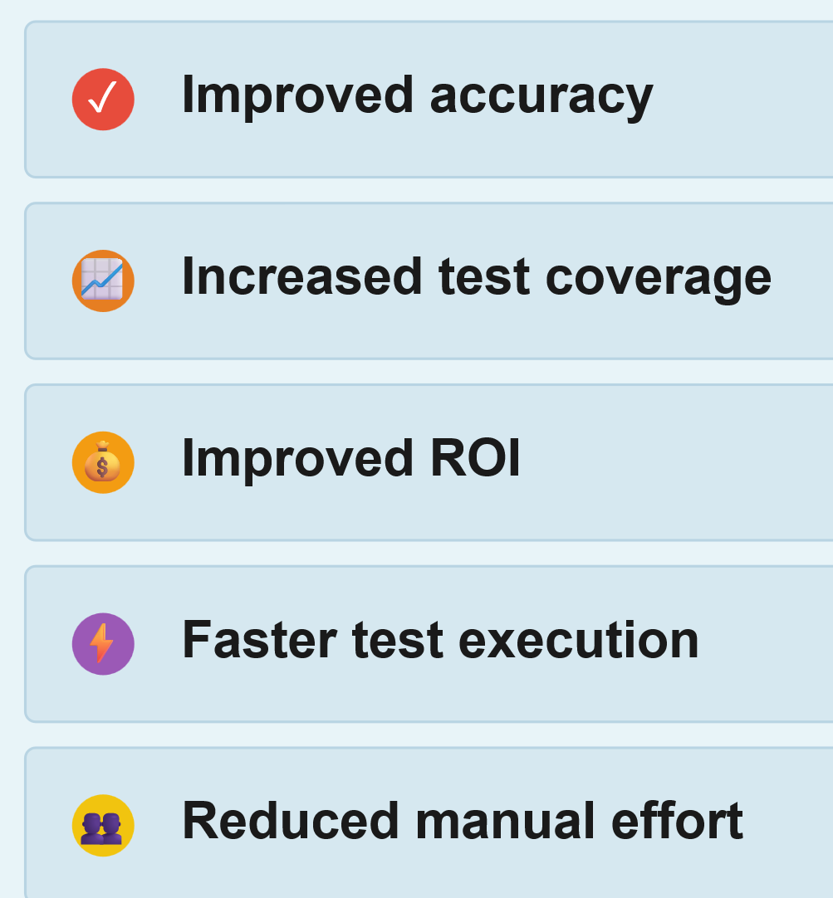
Benefits of AI in Testing (Why It Matters)
Faster Releases: Testing cycles shrink – AI testing at machine speed means quicker deployment and feedback to developers.
Higher Quality & Confidence: More defects caught earlier (AI doesn’t get tired or skip tests), leading to fewer production issues.
Efficiency & Cost Savings: Saves tester hours on repetitive tasks – focus humans on complex scenarios. Reduces costly late bug fixes​HEALTHCARE.MINDBOWSER.COM.
Adaptability: Tests don’t rot when the app evolves – AI-maintained suites stay up-to-date, which is great for long-term projects.
Team Morale & Collaboration: Lets manual testers participate in automation (via no-code tools), and frees experienced QA to do creative testing, not drudge work.
Notes:
These are essentially the “why” selling points. You can mention an anecdote: “One team reported their testers called the AI tool their ‘tireless intern’ handling the boring stuff.” If any attendees look skeptical, acknowledge AI isn’t a silver bullet but focus on these proven benefits. You might cite the earlier case: “Remember that hospital? They cut testing time by 85% – that’s the kind of efficiency we mean.”

Slide 43
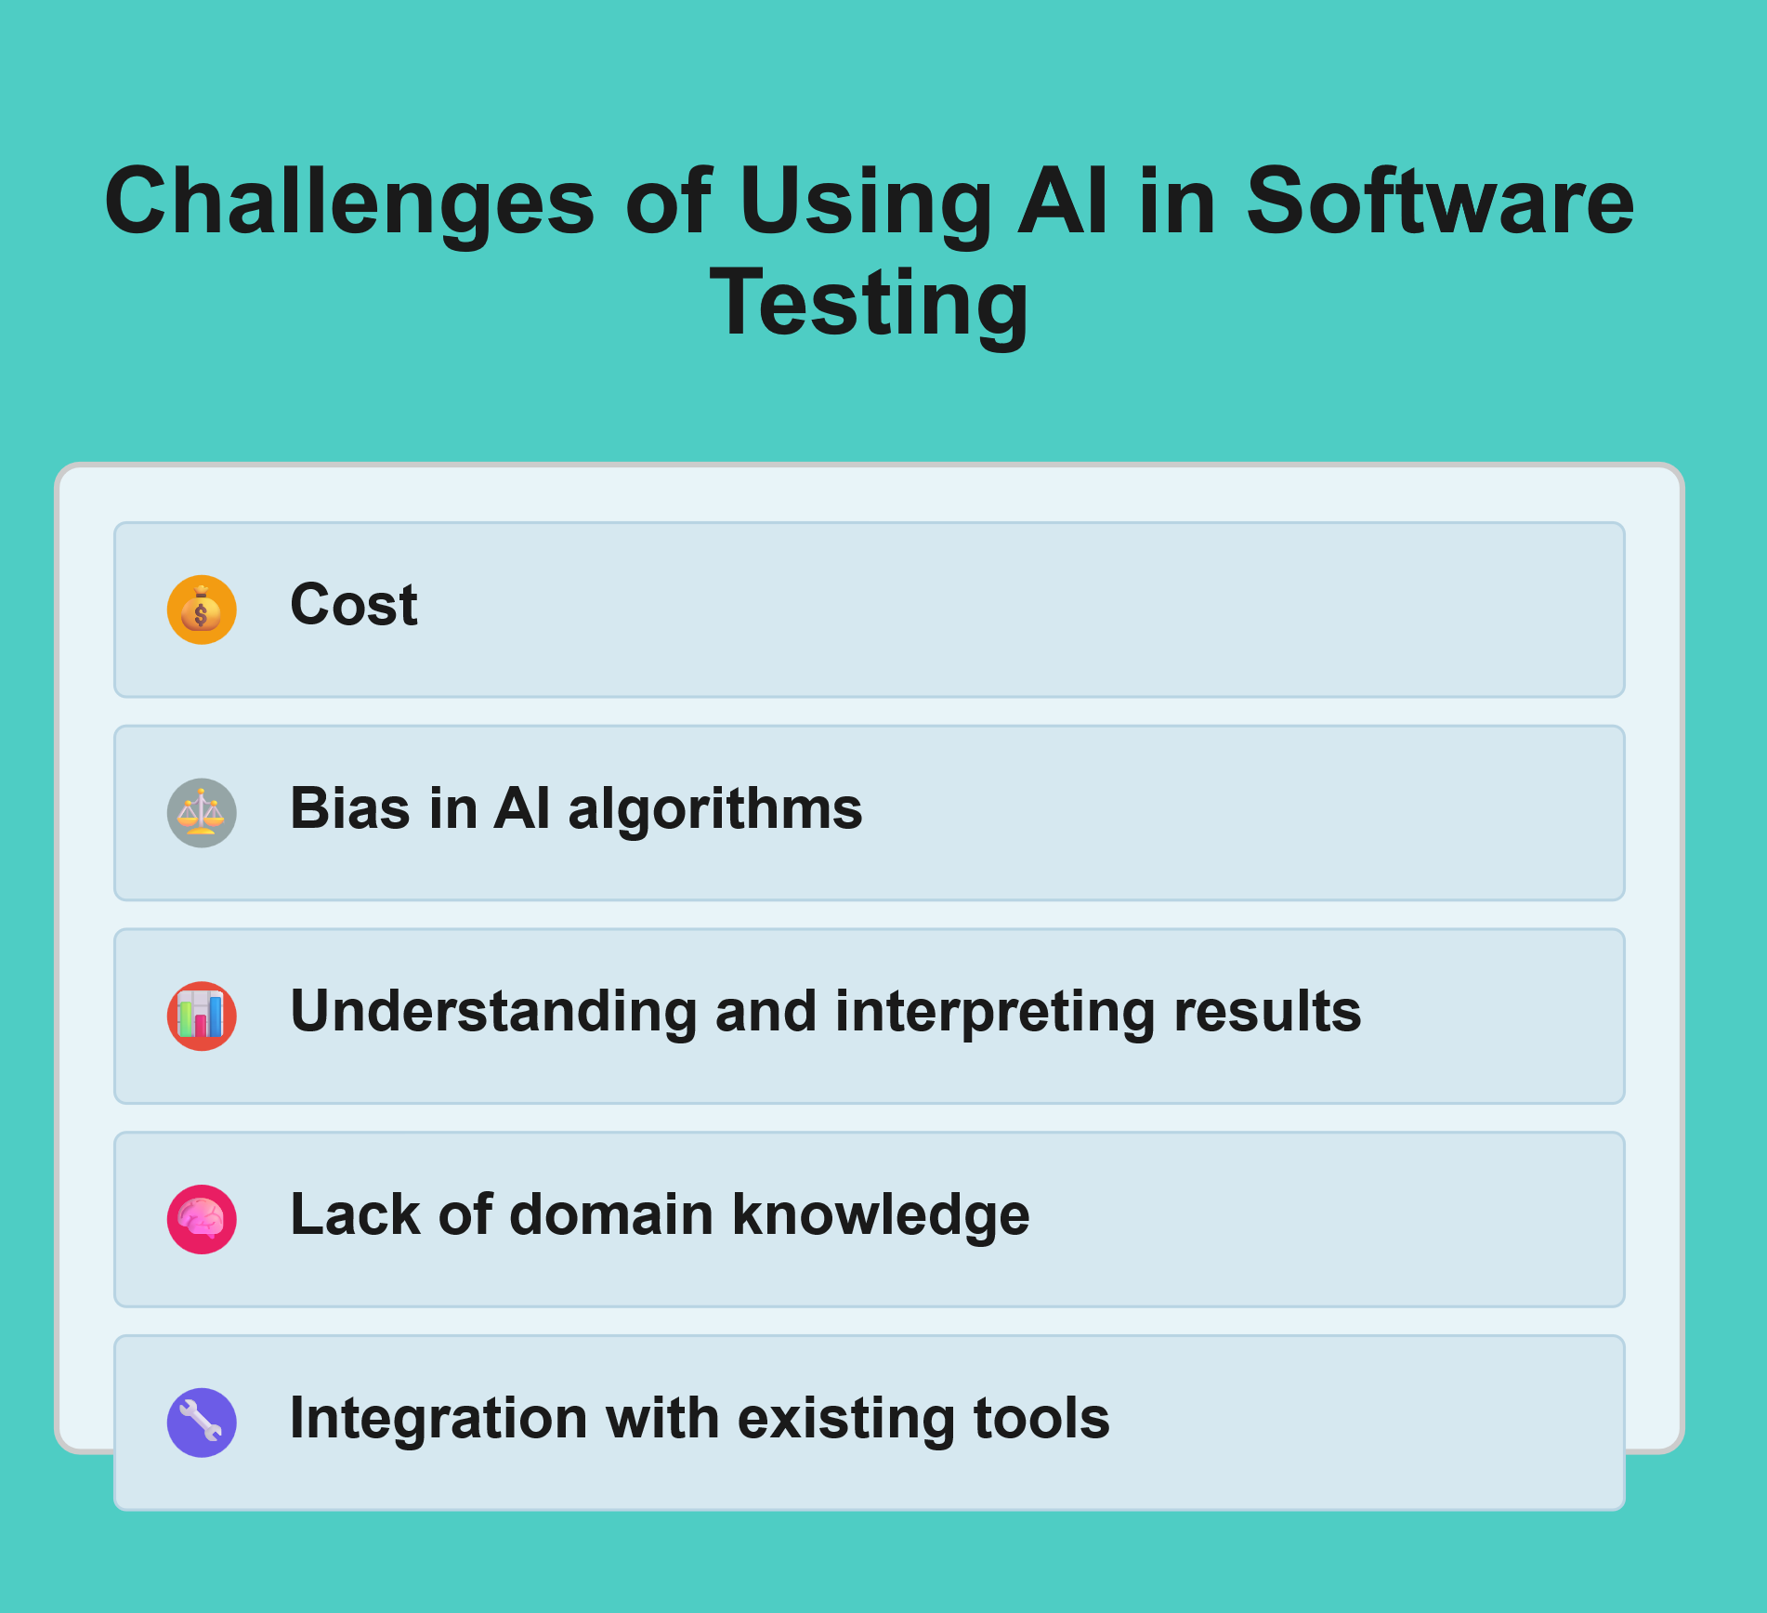
💰 Cost
Infrastructure and personnel investment details
Training and licensing cost factors
ROI timeline and budget ranges
⚖️ Bias in AI Algorithms
Training data bias issues
Over/under-testing scenarios
Monitoring and mitigation needs
📊 Understanding Results
Black box decision-making challenges
Skill requirements for interpretation
Explainable AI limitations
🧠 Lack of Domain Knowledge
Business context understanding gaps
Domain-specific training requirements
Human expertise vs. AI limitations
🔧 Integration Issues
Legacy system compatibility
Infrastructure overhaul needs
Workflow disruption factors

Slide 44
AI Testing Tools – Overview
Variety of Tools: Both open-source and commercial solutions exist (many with free trials).
No-Code/Low-Code Trend: Modern AI testing tools often have a friendly UI – you don’t need to write code to use AI features.
Key Capabilities:
Self-healing automation (e.g., Testim, Mabl) – tests that fix themselves when UI changes ​BROWSERSTACK.COM.
Visual testing (e.g., Applitools Eyes) – AI that spots visual diffs and regressions humans might miss​ DIGITALOCEAN.COM.
Natural language test creation (e.g., Functionize, testRigor) – write tests in plain English, AI generates the scripts.
Autonomous test generation (e.g., Appvance AI or Tosca) – tool explores the app or uses models to create new tests.
Integration: Many AI tools integrate with CI/CD (Jenkins, Azure DevOps) and work alongside traditional frameworks (Selenium, etc.).
Notes:
This slide sets up the landscape. We won’t deep-dive on each tool yet – just give a sense of what’s out there. Perhaps do a quick show of hands: “Who has heard of Applitools? Selenium?…” to gauge familiarity. Emphasize that these tools lower the barrier – even a manual tester can start automating with AI help.
Mention that after this, we’ll see some specific examples and a case study

Slide 45
Tool Spotlight – Self-Healing & ML
Testim (Demo) – AI-driven test recorder + self-healing. Benefit: reduced maintenance of UI tests​DIGITALOCEAN.COM.
Mabl – Low-code SaaS for web UI; ML auto-detects changes and failures​DIGITALOCEAN.COM. Benefit: anyone on team can add tests, AI keeps them stable.
Functionize – AI creates tests from your descriptions; adapts tests when your app changes​DIGITALOCEAN.COM. Benefit: speeds up test creation and upkeep drastically.
UST Platform – Quality Engineering Platform driven by GenAI
Notes:
In Testim, if a button’s ID changes, the test doesn’t break – it uses machine learning to find the button by other attributes.” For Functionize, “You can literally type: ‘Log in as user X’ and it will generate that test step.” These concrete examples make AI tangible. If possible, relate to audience: “Imagine for your university portal, writing a test in English – ‘enroll student in course and verify confirmation’ – how much easier would that be?”

Slide 46

Quick Quiz
Test your AI in QA knowledge!”
ID: 145-359-931
Grab your phones and go to vevox.app, enter the ID.
Questions about AI tools, benefits, etc.
Have fun!
Notes:
Mentimeter to go here
Perhaps, a word cloud here.

Slide 47
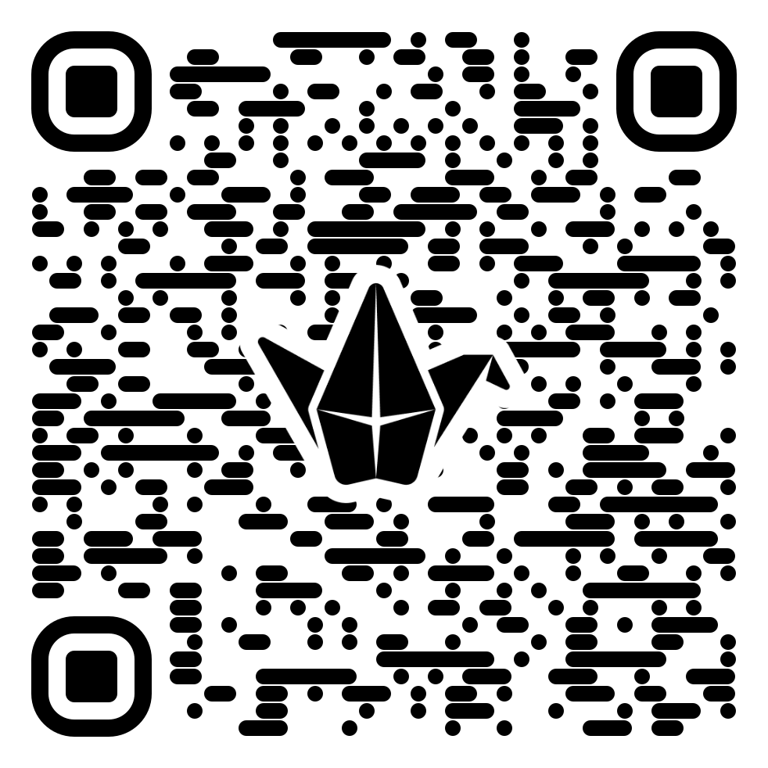
Activity (30 min): Industry-Specific Testing Challenges
In your groups, explore and identify specific pain points, bottlenecks, or challenges you have encountered related to software development and testing in your professional or personal experience.
Reflect individually for a moment on your experiences: As a software developer, tester, IT professional, or even an end-user, what difficulties have you encountered with software/web App/mobile App?
Consider areas like quality assurance, debugging, automation, test coverage, performance, integration, deployment, etc.
Engage in a short discussion within your groups:
Share your experiences and perspectives.
Discuss common themes or unique challenges.
Summarise your group's key insights and post them on the provided Padlet using the following structured format:
{Role} + {Context} + {Challenge}
Example:
As a lecturer in Higher Education, I struggle to efficiently verify the accuracy and completeness of student coding submissions due to limited automated testing methods.
bit.ly/discussionboard1

Slide 48
Interactive Breakout Sessions – Instructions
Breakout Topics: (on-screen list of the 10 topics, e.g., AI for Test Generation, Self-Healing, Visual Testing, etc.) – choose one that interests your group.
Group Formation: 5-8 people per group. (Suggestion: mix orgs/sectors in each group to enrich perspective.)Task: Discuss the questions on the handout/slide for your topic:
What challenge could this AI solution tackle in your work?
How might you implement it? Potential benefits?
What obstacles or requirements?
A possible next step to try it.
Output: Be ready to share one key insight
or idea after 20 minutes. Choose a spokesperson.
bit.ly/discussionboard1
Notes:
Mention the prepared flipcharts or notes. Remind them of timing – you will give a 5-minute warning. If people from the same team all go to one topic, that’s fine but also encourage mixing to avoid one group being all from one org unless they specifically want that. The list of topics is on the slide; quickly read them out and clarify if needed. Then let them break out.

Slide 49
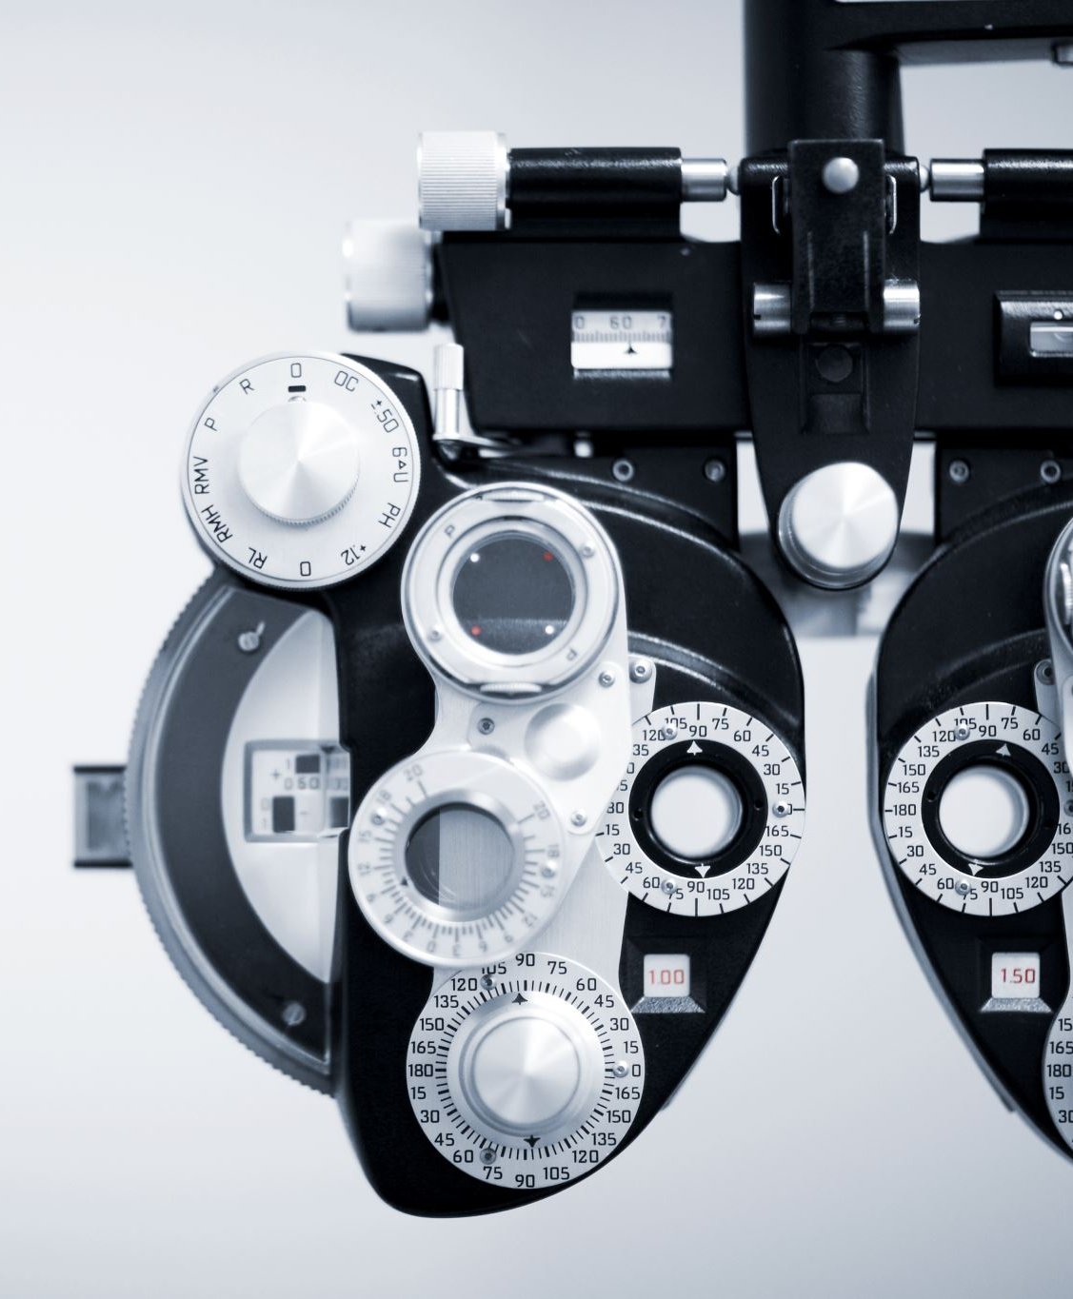
Tool Spotlight – Visual AI & Analytics
Applitools Eyes – AI-powered visual assertions. Use case: cross-browser/cross-device layout checks. Example: Ensures a NHS app’s UI looks correct on both IE and Chrome without pixel-by-pixel scripting.
Tricentis Tosca (Vision AI) – Enterprise-grade: recognizes UI elements by appearance (great for remote apps)​DIGITALOCEAN.COM. Example: Used for SAP, Citrix apps where normal automation fails.
Analytics & Predictive Tools: Some platforms (e.g., Launchable, QAnalytic) use AI to analyse test results and prioritize tests (find flaky tests, predict failures).
Notes:
Emphasize how visual AI can catch things like a misaligned button or wrong color scheme that functional tests overlook. Possibly mention, “Applitools was able to detect a single pixel misplacement that caused a checkout button to be partially hidden – a human might not script an assert for that.”
For Tosca, mention it’s heavy-duty but powerful, used in big enterprises with legacy systems. The last bullet introduces the idea of analytics – tie it to earlier discussion on defect prediction. “Imagine you have data from hundreds of test runs – AI can crunch that to tell you which tests likely cover new bugs. Some newer tools do that.”

Slide 50
Best Practices for Adopting AI in Testing
Start Small (Pilot Projects): Don’t overhaul everything at once – pick a small app or subset of tests to apply an AI tool and evaluate​TESTRAIL.COM.
Identify Clear Use Cases: Focus on a specific problem (e.g., “tests break often in module X” or “need visual validation”)​TESTRAIL.COM​TESTRAIL.COM. Apply AI where it can have quick impact.
Ensure Quality Data: If using ML, feed it relevant, clean data (test results, logs). For example, gather failure trends for defect prediction​TESTRAIL.COM​TESTRAIL.COM. Better data = better AI outcomes.
Team Training & Buy-In: Upskill your team – maybe a workshop on the chosen AI tool. Involve testers in tool evaluation so they trust the AI. Pair QA with data scientists if possible for advanced models​TESTRAIL.COM​TESTRAIL.COM.
Human Oversight: Treat AI suggestions as assistive, not absolute. Review AI-generated tests or bug predictions. Keep testers in the loop to validate and adjust.
Measure and Iterate: Define what success looks like (e.g., % reduction in execution time, increased coverage) and track it. Use those metrics to decide on broader rollout.
Notes:
This is guidance to ensure AI adoption actually succeeds. Anecdote: “One company tried an AI tool on all their tests at once and got overwhelmed. Then they narrowed to one workflow, tuned it, and it worked much better – so definitely start with a pilot.” Emphasize that AI isn’t a “set and forget” – it requires initial training and continuous tuning. Also note: “Some of you might worry AI will replace jobs – but really, think of it as augmenting your work. You still need to oversee and interpret results.”

Slide 51
Case Study – Risk Management & QA
Citibank – AI Risk Modeling: Used AI for financial risk analysis and automated stress testing. Outcome: 35% drop in operational losses related to software/system issues​. Essentially, AI predicted problem scenarios so they could be tested or mitigated in advance.
Big Tech (e.g., Microsoft) – Uses ML to prioritize tests in CI. Outcome: Huge test suites run faster by only executing likely-fail tests (saving compute resources and developer wait time)​.
Key Takeaway:
In regulated or mission-critical environments, AI helps manage risk in testing – ensuring you run the right tests at the right time. It leads to more proactive QA (finding potential failures before they occur in production) and aligns testing effort with business risk (you test what matters most first).
Notes:
Explain in plain terms: “Citibank’s AI basically told them where to focus their QA and operations efforts, rather than relying on gut feeling or outdated models.” For the Microsoft example, no need for deep detail, just, “Imagine skipping 70% of tests that are very likely to pass, and still catching 99% of failures – that’s what they aim for with AI test selection.” Encourage the audience to see that risk-based testing can be supercharged by AI – very relevant for both a university (think data breaches or downtime) and a hospital (think patient safety or system outages).
REDRESSCOMPLIANCE.COM
SOFTWARE-LAB.ORG

Slide 52
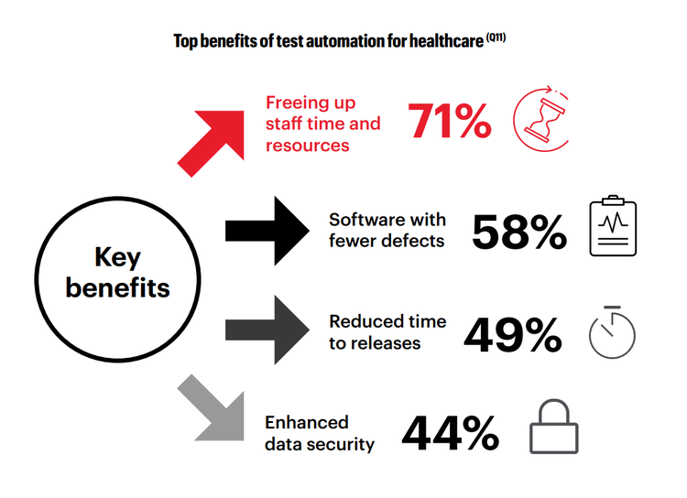
Case Study – Healthcare
UMHS (Hospital) – EMR Testing: Adopted AI test automation (Eggplant). Result: 85% reduction in testing time​KEYSIGHT.COM, thousands of test cases run overnight. Freed QA team to focus on critical clinical scenarios.
OUH (NHS Trust) – EHR via Citrix: Needed to test a remote EHR system. Chose an AI tool with image recognition. Result: Achieved reliable automation where traditional scripts failed​ KEYSIGHT.COM, improving release confidence and compliance (no missed steps in complex workflows).
Key Takeaway: AI can significantly improve efficiency and coverage in healthcare software testing – a domain where errors are costly. It handles tedious tasks (like data entry for tests) and complex UI interactions, letting testers concentrate on patient safety-related testing.
Notes:
Summarize the stories. “At Michigan, what took 2 weeks, AI did in 2 days ​keysight.com
. At Oxford, they finally could automate tests for their patient system that runs on a virtual desktop – something they couldn’t do at all before AI.” Connect that to audience: “If you’re in NHS IT, think about your own clinical or admin systems – could a similar approach save time or catch more bugs?

Slide 53
Reflection & Padlet Discussion: “How Can AI Help?
Case 1 – Healthcare:
A hospital’s patient record system must be tested regularly across several departments. Testers struggle with the repetitive nature of regression tests, UI changes after updates, and ensuring compliance with NHS data protection rules.
Case 2 – Higher Education:
A university IT team manages multiple student-facing applications. Frequent feature changes mean automated tests often break. Developers and testers work in separate teams and lack visibility into test priorities or risks.
Case 3 – Cross-Sector Risk Management:
A cross-sector software product is rolled out to both NHS Trusts and universities. It must be tested across various environments (browsers, devices, access levels). Failures in one configuration don’t always show up in others, and no one knows where the riskiest bugs might be.
Some questions to consider:
What testing or automation challenges exist in this scenario?
How could AI (tools, techniques, predictions, etc.) help?
What would be the ideal outcome if AI was used well?
bit.ly/discussionboard1
Notes:
This slide can be a placeholder for writing key points (if using an interactive board or just to guide the order of reporting). Alternatively, no fixed content – just a title “Group Debrief”. As each group presents, summarize their main point on the fly or thank them. After all, verbally highlight common themes, which leads into next steps

Slide 54
Wrap-Up & Next Steps
Key Takeaways:
AI in testing = faster, smarter testing + human expertise.
It’s a tool to help, not replace, QA.
Thank You & Q&A: (Time for questions – “No question is too basic or too tough!”)

Slide 55
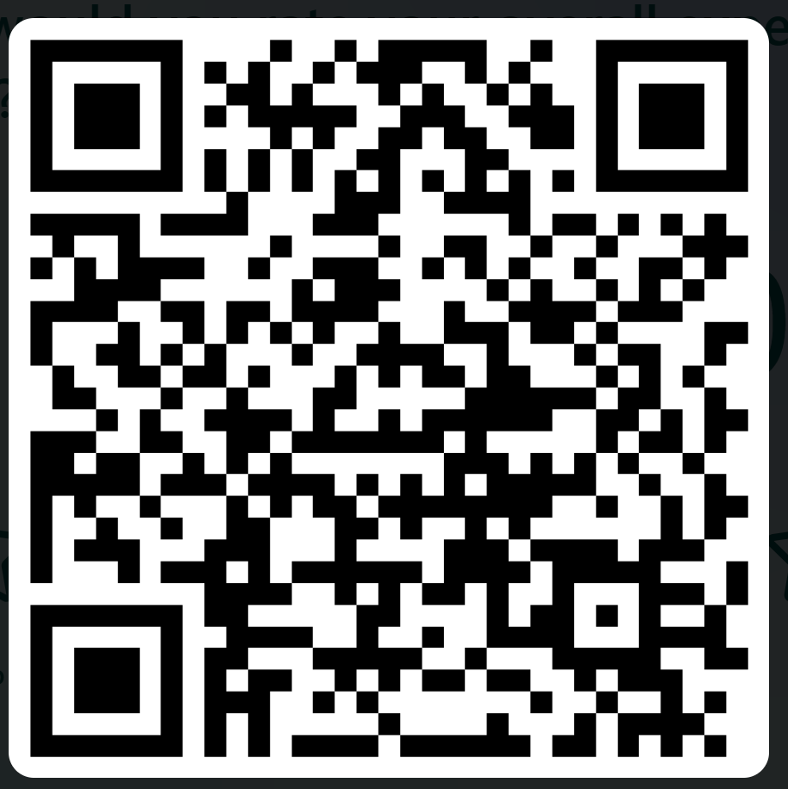
Thank you
QR Code for Feedback Survey
https://bit.ly/3XYO19K
Notes:
Share a QR code linking to a feedback form or resource page.

Slide 56
Intro AI-Led Testing
Day 1 - Session 2 (13:30 – 15:00)
Industry trends
Evolution from Automated to AI-driven Testing
March 2025

Slide 57
Day 1 Session 2 Schedule
20 mins: Introduction to popular AI testing tools (UST Platform, Testim)
15 mins: Tool Demonstration (hands-on examples)
45 mins: Group Workshop – match scenarios to AI tools
25 mins: Group Presentations & Analysis
15 mins: Q&A and best practices
Notes:
Applitools, Sauce Labs

Slide 58




Day2 topics
Evolution of testing
AI driven test automation

Slide 59





Evolution of testing
Autonomous testing- AI driven testing creates and runs tests. Faster test development and execution. Still early days of adoption, evolving and need to gain trust.
Model based testing- Tests created based on application models such as UI and behavior. Easier to maintain, low-code or no-code approach.
Script based testing- Automated tests written in programming language, faster execution. Reusable but higher maintenance.
Manual testing- early days with manual test case creation, execution, analysis of results. Prone to human error, not scalable, high on time and effort.

Slide 60

AI driven test automation
Autonomous AI
Autonomous test design: Translate business intent into test cases; gap analysis, prior tests
Autonomous testing: Automated regression and progressive testing from a given intent
Generative AI
Test creation: Automated test case creation from requirements
Intelligent assistance: Help users in performing tasks
Application exploration: Learn an application, process map and generate test scenarios
AI/ Machine learning
Visual: Auto detection of UX elements and controls
Self-Healing: Auto recovery from application changes
Risk: Analysis of impact from code and data changes
Detection: UX, performance and network issues

Slide 61



UST QE Platform : Continuous testing platform to encapsulate the best practices for seamless adoption
UST QE Platform continuous Quality Engineering platform
Automation Accelerators
AI Powered Decision funnels
Gig-BOTs & User Assistants
Prefabricated automation packs
Automation Savings Calculators
Automated Test Generators
Scriptless/Scripted Automation Engines
Visual Testing & Client-side Performance Plugins
User Story Validations
Test Case Optimizers
Change Impact Analyzers
Production Feedback Analyzers
Test Analytics
Data Provisioning Buddy
Self-Healing Plugins
Test Reporting Genie
Test Execution Assistants
Enterprise quality dashboard
Pre-built integrations
Integrations with DevOps & Test Life Cycle Tools | Real-Time Analytics Dashboard | Cloud-Based Device & Browser Labs
UST offers a unique platform + services model which includes UST QE Platform and pre-integrated partner tools for Change impact analysis, TDM, high volume data testing etc.

Slide 62
Why Move from Automated to AI Testing?
Automated tests often break due to minor UI changes
High maintenance efforts to fix tests frequently
AI Testing adapts automatically, significantly reducing maintenance effort
AI-driven visual testing quickly detects UI/UX issues
Notes:
Interactive Element:
Short Video Clip: Insert a short (1-minute) clip or GIF demonstrating a flaky test that breaks, then show how AI self-healing fixes it.

Slide 63
Activity (15 minutes)
Have you experienced frequent automated test breakages due to UI changes?
Share your responses on Padlet
bit.ly/discussionboard1

Slide 64
AI Testing Tools – Quick Overview
UST Platform: AI-augmented Quality Engineering platform, option for low-code or scripted for functional, mobile, and API testing (Free demo/trial)
Testim: AI-driven self-healing tests, ideal for UI automation (Free community tier)
Applitools: AI-based visual testing, detects subtle UI anomalies (Free tier available)
Sauce Labs: Cloud-based testing, NLP-based test generation, AI-driven analytics (Free trial available)

Slide 65
Activity: Have you used them before? (5 min)
Anyone have experience with any of these tools?
Please share in 1 sentence what you liked or didn’t like.
bit.ly/discussionboard1
Notes:
WordCloud to capture their feedback

Slide 66
Live Demo 1 – AI Self-Healing with Testim
AI’s ability to adapt to UI changes
Steps:
Record a simple login test using Testim
Run the test successfully
Make a minor UI change (e.g., rename a button)
Run the test again without modification
Observe AI-driven test "self-heal"

Slide 67
Challenge: Spot the Change
Here is a screenshot of a page before/after a small UI tweak.
Who can spot the difference?
Let’s see how Testim’s AI locators handle it.

Slide 68
Demo:
Live Demo Outline:
Navigate to test site
Record a simple login test
Change element name
Rerun and show self-healing
Notes:
Replace with pre-recorded video if it is not possible to deliver this live on the session
Ask for audience input: “Which button should I click next?” Let them guide the steps, making it fun.

Slide 69
Demo 2: Applitools Visual AI
Key Concepts:
Baseline screenshots
Intelligent comparison
Handling dynamic content

Slide 70
Quick Quiz:
Which type of bug would a normal functional test MISS, but a visual test CATCH?
A) Changed button text
B) Overlapping UI element
C) Missing data field
Notes:
Answer: Overlapping UI or subtle layout shifts are prime examples.

Slide 71
Demo 2: Live/Video
Live Demo Steps:
1. Setup Applitools Eyes
2. Capture baseline
3. Introduce small UI shift
4. Observe flagged differences
Interactive Element:
Audience Prediction: “Raise your hand if you think the AI will flag the changed color as a bug?” Then show the actual result.

Slide 72
Applitools snippet
eyes.open(driver, "Demo App", "Test Name");
driver.get("https://demo-app.url/login");
eyes.checkWindow("Login Page");
eyes.close();
Interactive Element:
Who here can guess how many lines of code you’d need for a standard Selenium test to do visual checks without AI?
Notes:
Attendees might guess 10–20 lines. Emphasize how the AI approach is simpler.

Slide 73
Group Workshop Instructions
Groups → ~5 participants each
Choose 1 scenario from 10
Match it to an AI testing tool
Note key benefits & limitations
Prepare a short 2-min presentation
Notes:
People interested in e-commerce scenarios, gather to my left; those interested in healthcare, to my right.

Slide 74
AI Testing Scenario
E-commerce Cart with UI Changes
Healthcare Portal Visual Consistency
Cross-Browser Testing for University Site
NLP-based Test Generation
Mobile App for Patient Check-In
API Testing with Frequent Schema Updates
Accessibility + Visual Testing
Automated Test Creation from User Analytics
Clinical Data Dashboard with Live Updates
Large Regression Suite Optimization

Slide 75
Group Discussion
Discuss scenario
Write some test case scenarios.
Which AI tool to use?
Why does it suit your scenario?
Potential drawbacks or limitations?
Prepare a 2-min summary.
Clearly state chosen scenario
Present selected AI Testing tool
Why this tool is best suited (AI features specifically relevant)
Mention at least one limitation or challenge
Notes:
Workshop Facilitator
Set a timer for 15 minutes in, do a quick “check-in.” “Halfway point: does every group have a chosen scenario and tool?”
Provide guidance if needed.

Slide 76
Guided Q&A
Possible Topics:
Practical integration
Handling limitations
Best practices
Future of AI in testing
Notes:
Does anyone have a real use case question for the group?
Encourage knowledge-sharing from advanced participants.

Slide 77
Best Practices & Next Steps
Start Small: Pilot AI testing with a simple, controlled scenario
Maintain Human Oversight: AI complements, not replaces, human testers
Update Test Baselines: Regularly refresh screenshots, selectors, and test data
Combine AI & Manual Testing: AI handles repetitive tasks; humans handle creative, exploratory scenarios
Share Knowledge Internally: Document and share experiences to build collective expertise
Notes:
Take 30 seconds to jot down 1 action item you’ll do next week to explore AI testing further.

Slide 78
Thank you
QR Code for Feedback Survey
https://bit.ly/3XYO19K
Notes:
Share a QR code linking to a feedback form or resource page.

Slide 79
Intro AI-Led Testing
Day 1 - Session 3 (15:30 – 16:30)
Integration of Generative AI in Testing
March 2025

Slide 80
Session 3 Overview / Agenda
10 min: Introduction to Real-Time Testing and Predictive Analytics
Real-Time Testing Explained
10 min: Live Demonstration
25 min: Hands-On Practical Activity
15 min: Group Discussion & Summary

Slide 81
Introduction to Generative AI in Testing (Part 1)
What is Generative AI?
AI that creates new content (text, images, code) from patterns in large datasets
Commonly powered by Large Language Models (e.g., GPT, Gemini)
Capable of generating test scenarios, scripts, and synthetic data
Key AI Tools for Testing:
UST Platform: Secure experimentation with AI-driven testing solutions
ChatGPT: Conversational AI for generating test cases, code snippets, documentation
Gemini (Google): Next-generation AI model for more complex, multimodal tasks
Automated Data Generation Tools: No-code solutions to create realistic synthetic data

Slide 82
Introduction to Generative AI in Testing (Part 2)
Benefits of AI in Testing:
Faster Test Case Generation (reduce manual effort)
Broader Test Coverage (including edge cases)
Self-Healing Tests (scripts adjust automatically to minor UI changes)
Improved Defect Detection (AI-flagged anomalies, predictive analysis)
Challenges of AI in Testing:
Data Quality / Bias in AI outputs
Skill Gaps (learning prompt engineering, AI tooling)
Integration Issues with existing tools / pipelines
Validation & Oversight (human review is still essential)

Slide 83
Live Demonstration Overview
Objectives:
Show AI-generated test scenarios from a simple prompt
Demonstrate synthetic test data creation with a no-code tool
Highlight cross-industry applicability (healthcare, education, finance, etc.)
Demo Flow:
Prompt an AI (e.g., ChatGPT) with a requirement (e.g. user login)
Review generated test cases (functional, negative, edge)
Generate synthetic data (e.g., 50 user profiles)
Discuss how to refine AI outputs (prompt tuning, verifying correctness)

Slide 84
Activity
Given a requirement “If the user enters an invalid email, the system should show an error message,” Come up with test cases covering various invalid email formats and the expected error responses.
Keep count of tests and scenarios you have considered.
Next, we will do it with AI.

Slide 85
Hands-On Practical Activity (Part 1)
Step-by-Step Instructions:
Form Groups: ~4–6 people per group
Select a Scenario from the predefined list
Manual Test Scenario Creation:
Brainstorm 3–5 test cases as if no AI is available
Document them in Google Docs / Miro / or paper
Activity Goal:
Compare your manual approach vs. AI-assisted approach
See if AI helps discover new test cases or expedite test design

Slide 86
Hands-On Practical Activity (Part 2)
Transition to Low-Code / No-Code Automation:
Take one test scenario from your manual list
Give examples of a low-code tool (e.g., Mabl, Testsigma, or any UST Platform environment)
Record/define steps in plain English or via a record-and-play feature
Generate an automated script or test flow
Next: AI-Generated Test Cases & Scripts
Prompt an AI (ChatGPT) to generate additional test cases or code
Compare the AI’s suggestions with your initial list
Evaluate correctness and coverage

Slide 87
Ten Predefined Scenarios
Patient schedules an appointment via an online hospital portal
Doctor updates a patient record in the EHR system
Student enrolls in a course through a university registration system
Teacher uploads grades to an online student management platform
Customer transfers money using an online banking application
User applies for a loan on a banking website
Shopper completes a purchase on an e-commerce website
Traveler books a hotel room through an online booking system
Employee onboards through a company HR portal
Citizen submits a passport application on a government services site

Slide 88
Discussion Questions
Discuss scenario
Which AI tool to use?
Why does it suit your scenario?
Potential drawbacks or limitations?
Prepare a 2-min summary.

Slide 89
Group Discussion & Evaluation
Group Presentations (~2 mins each):
Which scenario did you choose?
How did your manually created cases compare with AI-generated ones?
Any surprises from the low-code or AI-generated scripts?
Discussion Points:
Feasibility & effectiveness of using AI in real projects
Challenges faced (prompting, domain specifics, output validation)
Potential next steps or use cases in your own organization

Slide 91
Mahadesha Subramanyam
Shajahan Puzhakkal Pulikkal
Kailas Sivasankaran
Daniel Gonzalez Gustov
Dr Yashar Baradaranshokouhi (Yash.B@leedsTrinity.ac.uk)

Slide 92
Key Takeaways & Next Steps
AI as a Test Accelerator:
Rapid test case design, expanded coverage, synthetic data generation
Still requires human expertise to refine, validate, and prioritize
Lessons Learned:
Iterative prompting leads to better AI output
Data quality & privacy must be considered (especially in sensitive domains)
Embrace AI gradually, integrating into existing workflows
Action Items:
Explore free trials of AI testing tools (Mabl, Testsigma, etc.)
Practice prompt engineering on your own projects
Engage stakeholders early to address adoption concerns
Thank You & Contact
Questions?
Notes:
Provide contact details

Slide 93
Gen AI Powered QE Capabilities Day 2 – Session 1 09:30 – 12:30
March 2025

Slide 94
Senior HR Business Partner
Keynote Speaker
Seena Mohan
March 2025

Slide 95
UST QE Platform : Continuous testing platform to encapsulate the best practices for seamless adoption
UST QE Platform continuous Quality Engineering platform
Automation Accelerators
AI Powered Decision funnels
Gig-BOTs & User Assistants
Prefabricated automation packs
Automation Savings Calculators
Automated Test Generators
Scriptless/Scripted Automation Engines
Visual Testing & Client-side Performance Plugins
User Story Validations
Test Case Optimizers
Change Impact Analyzers
Production Feedback Analyzers
Test Analytics
Data Provisioning Buddy
Self-Healing Plugins
Test Reporting Genie
Test Execution Assistants
Enterprise quality dashboard
Pre-built integrations
Integrations with DevOps & Test Life Cycle Tools | Real-Time Analytics Dashboard | Cloud-Based Device & Browser Labs
UST offers a unique platform + services model which includes UST QE Platform and pre-integrated partner tools for Change impact analysis, TDM, high volume data testing etc.

Slide 96





UST Platform GenAI capabilities, delivering accelerated test automation 30% faster >30% cheaper
Context layer built on UST’s domain and technical expertise helps improve accuracy by >40%
Requirement
Plan
Design
Test Data
Execution
Reporting
Auto-generate user stories from diverse product inputs, including text, images, audio, and more.
Auto-generate Test Strategy
Auto-generate Test Scenarios
Synthetic Data Generation
Identify DAST scenarios and execute in un- attended manner
Generate delta test scenarios from past defect logs
2
4
8
9
11
1
Convert Manual test pack into bdd test scenarios
Automated User Story Validator and Auto-Correction
5
Convert Customer Reviews in the App Store into Test Packs
Automated Image Validation: Objects, Content and Properties
3
Auto Generate Automation Scripts
10
12
6
Auto Generate Performance Scripts
7

Slide 97
User Story 1: Let's assess the accuracy and effectiveness of the test design
Generate test scenarios:
Title: Find the best postgraduate course at Leeds Trinity University
As a prospective postgraduate student, I want to navigate from the home screen to browse and filter postgraduate courses, so that I can find a course that aligns with my career goals and academic interests.
Acceptance Criteria:
From the home screen, the user can access a list of postgraduate courses.
The user can filter courses by relevant criteria
Each course should provide necessary details
The user should be able to compare multiple courses for easier decision-making.

Slide 98
User Story 2: Let's compare the outcomes of the test design.
Generate test scenarios:
Title: Find the best postgraduate course at Leeds Trinity University
As a prospective postgraduate student, I want to easily navigate from the home screen to postgraduate courses, browse and filter available options, so that I can find a course that suits my career goals, academic interests, and preferred study mode.
Acceptance Criteria:
From the home screen, the user can access the "Postgraduate Courses" link under the "Courses" section.
The user is directed to a page listing all available postgraduate courses with essential details, including course name, subject area, and study mode (full-time, part-time, with placement).
The user can use filters to refine the list based on:
Course type (e.g., Master's, Doctorate), Study mode (e.g., Full-time, Part-time, Online), Subject area (e.g., Business, Education, Media)
Each course has a dedicated page providing detailed information about:
Course description, Entry requirements, Tuition fees, Career prospects, Duration and study mode
The user can access a search bar to find specific courses by name or keyword.
Users can compare different postgraduate programs to find the one that best fits their needs and interests.
The user can easily navigate back to the home page or explore other related sections (e.g., fees, applying, open days).

Slide 99
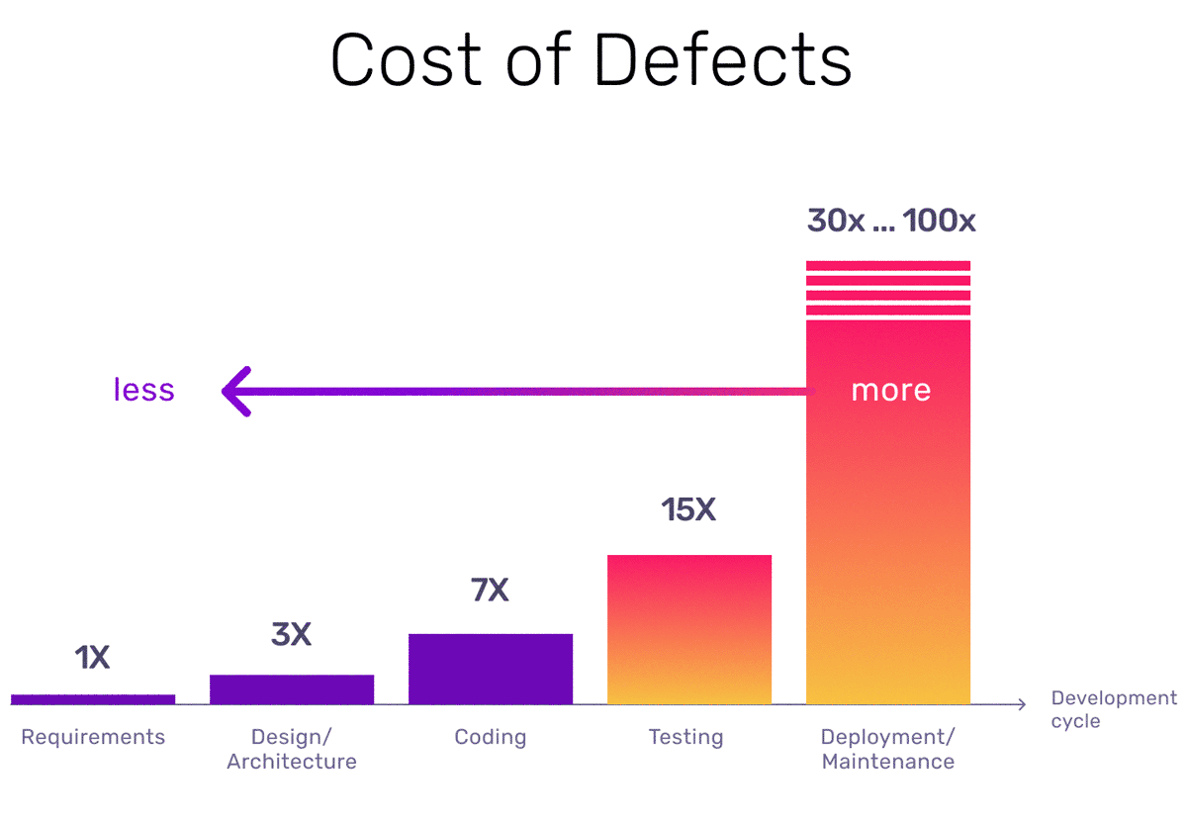


Slide 100
UST Platform GenAI capabilities, delivering accelerated test automation 30% faster >30% cheaper
Context layer built on UST’s domain and technical expertise helps improve accuracy by >40%
Requirement
Plan
Design
Test Data
Execution
Reporting
Auto-generate user stories from diverse product inputs, including text, images, audio, and more.
Auto-generate Test Strategy
Auto-generate Test Scenarios
Synthetic Data Generation
Identify DAST scenarios and execute in un- attended manner
Generate delta test scenarios from past defect logs
2
4
8
9
11
1
Convert Manual test pack into bdd test scenarios
Automated User Story Validator and Auto-Correction
5
Convert Customer Reviews in the App Store into Test Packs
Automated Image Validation: Objects, Content and Properties
3
Auto Generate Automation Scripts
10
12
6
Auto Generate Performance Scripts
7

Slide 101


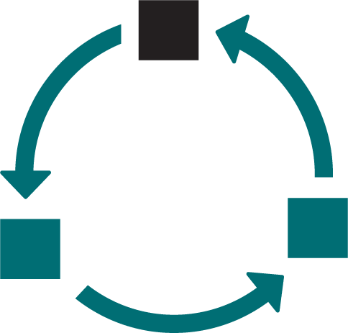










GenAI Powered Test Suite Creations
Step 1
Validate User Stories
Step 2
Generate Test Scenarios
Step 3
Generate Test Scripts
User Story Analysis
Test case Analysis
User
Validate against standard principles using LLM
Analyse Framework Components
Generate test scenarios using User Stories, project context, and reference document
Generate Compatible Code Snippets for Test Cases
Extract User Stories from JIRA/ADO
Validation Results
Extract test cases from JIRA/ADO
Extract User Stories from JIRA/ADO + Reference Document
Project Context
Generate corrected version of User stories
Project Context
Align test cases to a customised format with required steps
Automation Script File Tailored for the Framework
Project Repository: JIRA/ADO
User Story update into Project repository
Project Repository: JIRA/ADO
Test pack update
Git REPO
Script review and update for test execution
Direct Import of the new script into the Git REPO
SME review of User Stories
SME review update
40-50% reduction in user story related defects
>10% improvement in test coverage
> 50% savings in Test Scenario creation effort
> 40% savings in Test Script creation effort

Slide 102
Panel Discussion Day 2 – Session 2 13:30 – 15:00
March 2025

Slide 103
Industry Case Studies Q&A Networking session Day 2 – Session 3 15:30 – 17:00
March 2025

Slide 104




UST Industry case study #1: streamlining test case generation for enhanced efficiency and accuracy
Client – technology industry
A global leader and pioneer in networking and cybersecurity, delivering innovative solutions that drive digital transformation and business success
Business Challenge
Manual test case creation was time-consuming and error-prone. This slowed down testing and increased the effort needed. Resulting in lower efficiency, longer project timelines, and poor quality needing further intervention.
Solution
UST’s GenAI-powered test case generation streamlined the test case generation activity. Automatically creating custom test packs from inputs such as business requirements, solution and functional specifications, and topology diagrams, complete with detailed execution steps.
Outcome
Automated test cases generated with detailed steps and preconditions improved the quality and coverage, minimizing manual effort and errors. Improving accuracy, while reducing testing effort by 50%, and boosting efficiency and accelerating project timelines.
104

Slide 105
UST Industry case study #2: solving the hidden cost of mismatched product images and a scalable solution
Client – retail industry
A top 5 fashion retailer in the UK with a vast online presence- 12 million visitors a month and 400,000 unique customers accessing their product catalog daily.
Business Challenge
Customer trust and experience in online shopping was significantly affected, due to poor content and mismatches on their Product Listing Pages. Resulting in abandoned shopping carts and falling confidence in the brand. Which led to lost revenue and operational inefficiencies, with the potential financial impact projected at £80-100 million annually.
Solution
UST’s QE Platform with AI-powered image validation, automated the process of validating product images against the correct listings. The solution scanned images to detect mismatches, flagged discrepancies, and automatically logged issues. A solution scalable to meet product volumes and address issues quickly.
Outcome
UST’s QE Platform validated around 40,000 products during the initial rollout, detecting the mismatches which was around 5% in a span of just two weeks. This significantly reduced manual oversight, increased image accuracy, enhanced conversion rates and ultimately improved the customer experience and trust by ensuring the right products were shown with the correct images.
105

Slide 106
Activity: Have you used them before? (5-10 min)
Reflect on the event and platforms you have seen.
How do you plan to use them in your field/industry?
What business impact will you look to make in the future?
Please share some comments on the Padlet link.
bit.ly/discussionboard1
Notes:
WordCloud to capture their feedback

Slide 107
Thank you
QR Code for Feedback Survey
https://bit.ly/3XYO19K
Notes:
Share a QR code linking to a feedback form or resource page.

Slide 110
Mahadesha Subramanyam
Shajahan Puzhakkal Pulikkal
Kailas Sivasankaran
Daniel Gonzalez Gustov
Dr Yashar Baradaranshokouhi (Yash.B@leedsTrinity.ac.uk)

